Slide 1
Agenda For Today
Take roll
Course Overview
PCB Overview
Designing PCB overview
Lab overview

Slide 2
CSE176e/276e: Robotic Systems Design and Implementation
Dr. Steven Swanson
CSE176e/276e
swanson@cs.ucsd.edu
Course Homepage: http://goo.gl/XYwuoy
To achieve great things, two things are needed: a plan and not quite enough time.
--Leonard Bernstein

Slide 3
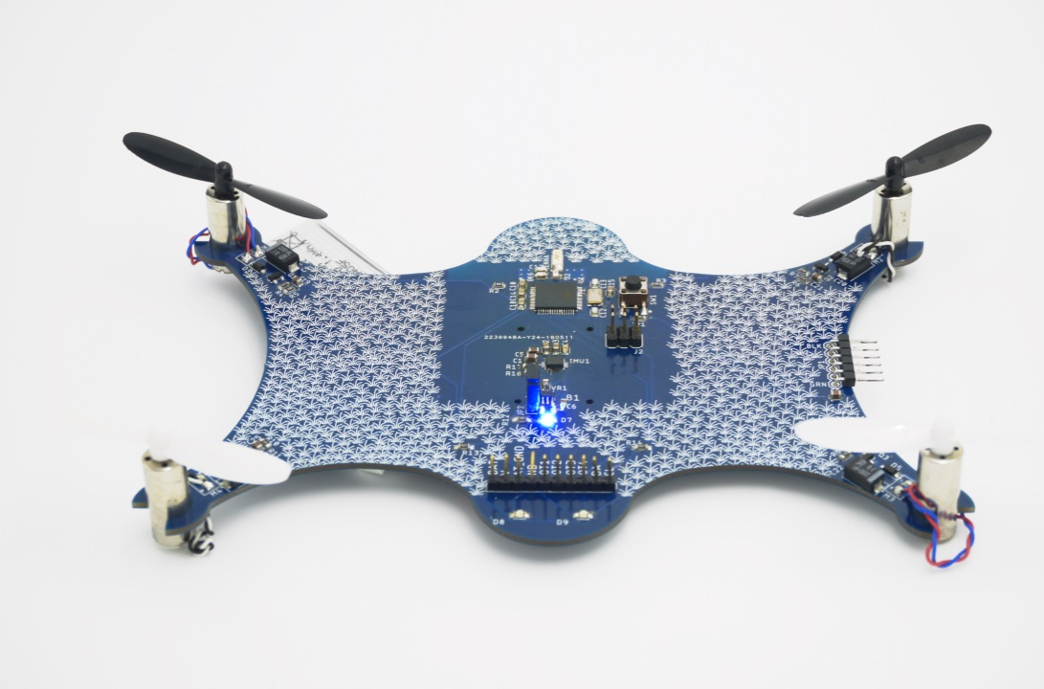
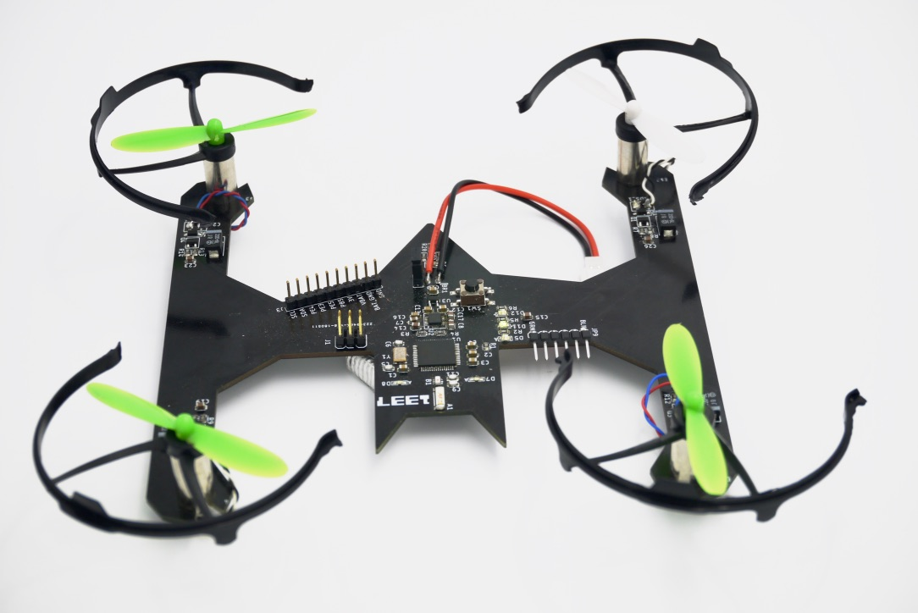
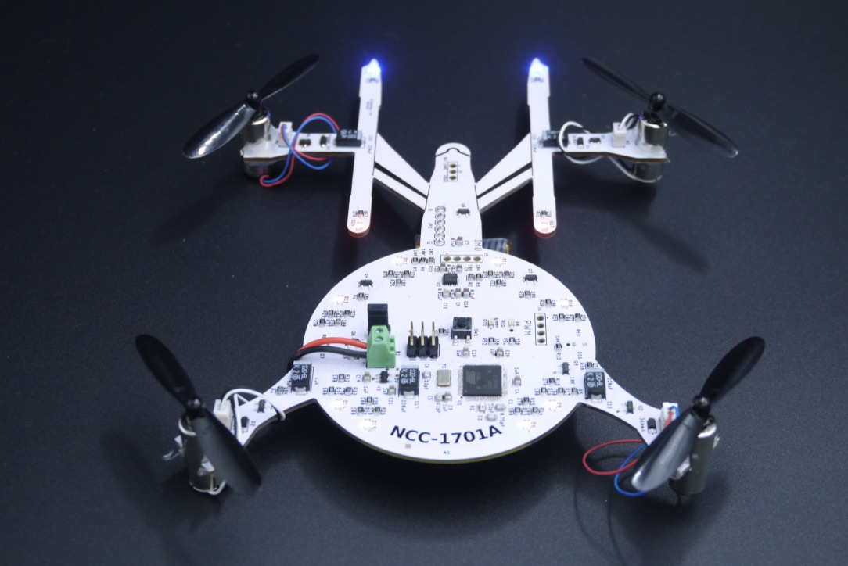
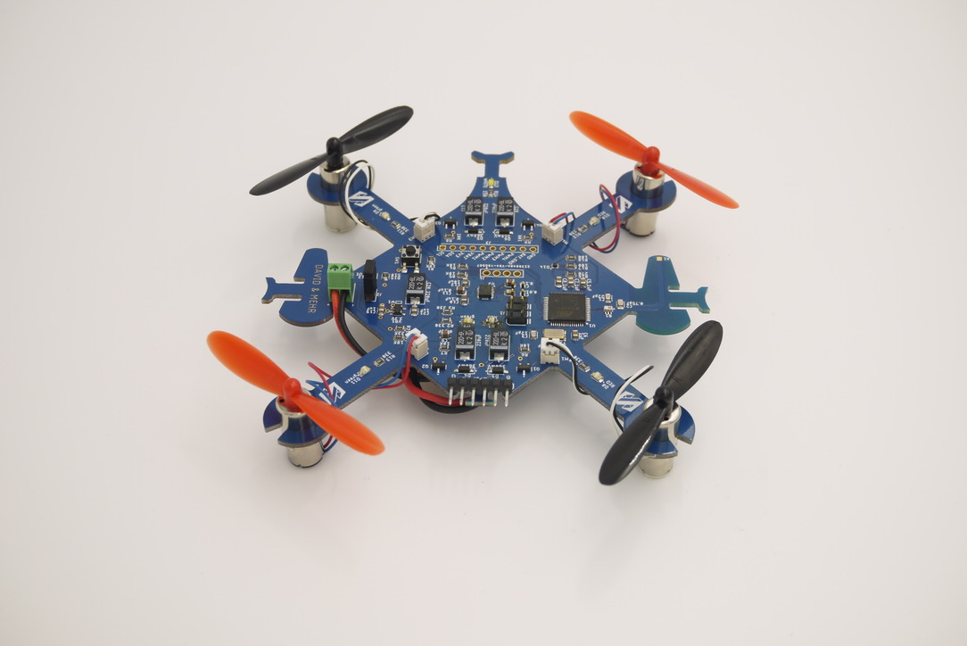
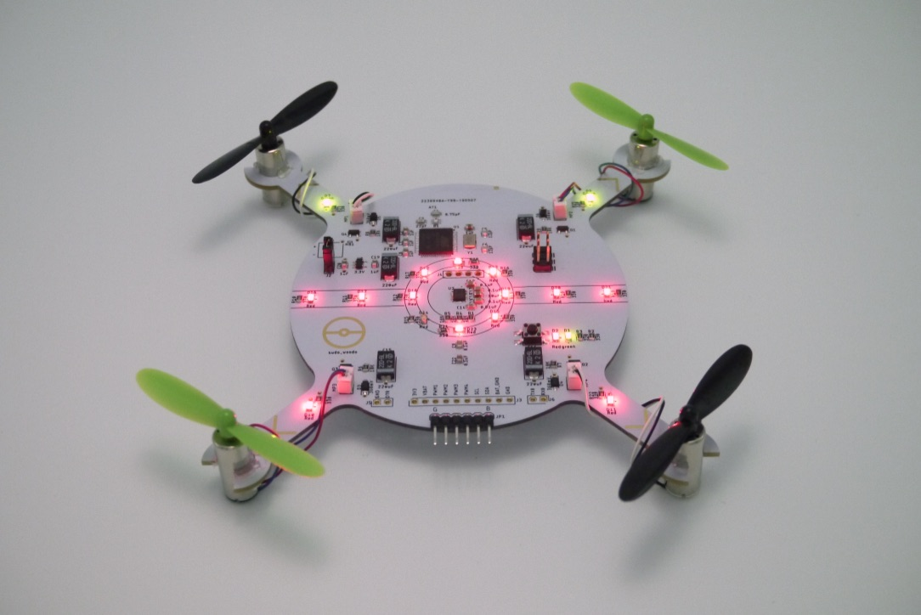
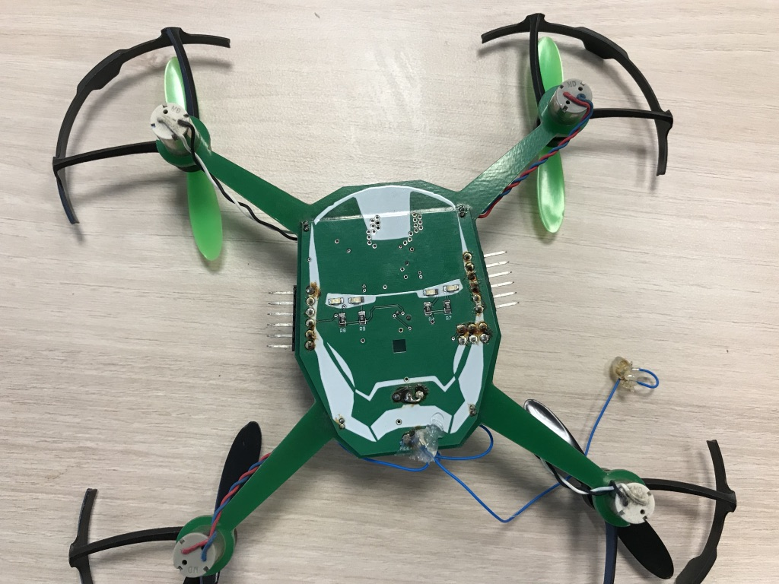
Course Goals
Design, build, and program a small quadcopter
In 10 weeks
Mostly “from scratch”
You’ll Learn
Moderately complex PCB design
Basic sensing and control
Embedded software development
You won’t learn
In-depth control theory
Advanced quadcopter stuff
Autonomous flight

Slide 4
Course Schedule Outline
Main goal: Start testing/refining flight control software on your quadcopter ASAP.
Weeks 1-4: Sprint to a PCB design, do preliminary software development
Most important date: April 30th – Board “tape out”
Weeks 5-10: Software refinement, quad assembly, refinement and testing.
Schedule is here: https://goo.gl/cNkR3C

Slide 5
Lab Overviews

Slide 6

Introduction To Eagle Fusion360 (Electronics)
Design a simple schematic.
Turn it into a board design.
Generate manufacturing data.
Perform manufacturing checks.
Design some new parts for the Fusion360 library.
Learn to decorate your boards.
This is due next class(Very Soon!)

Slide 7
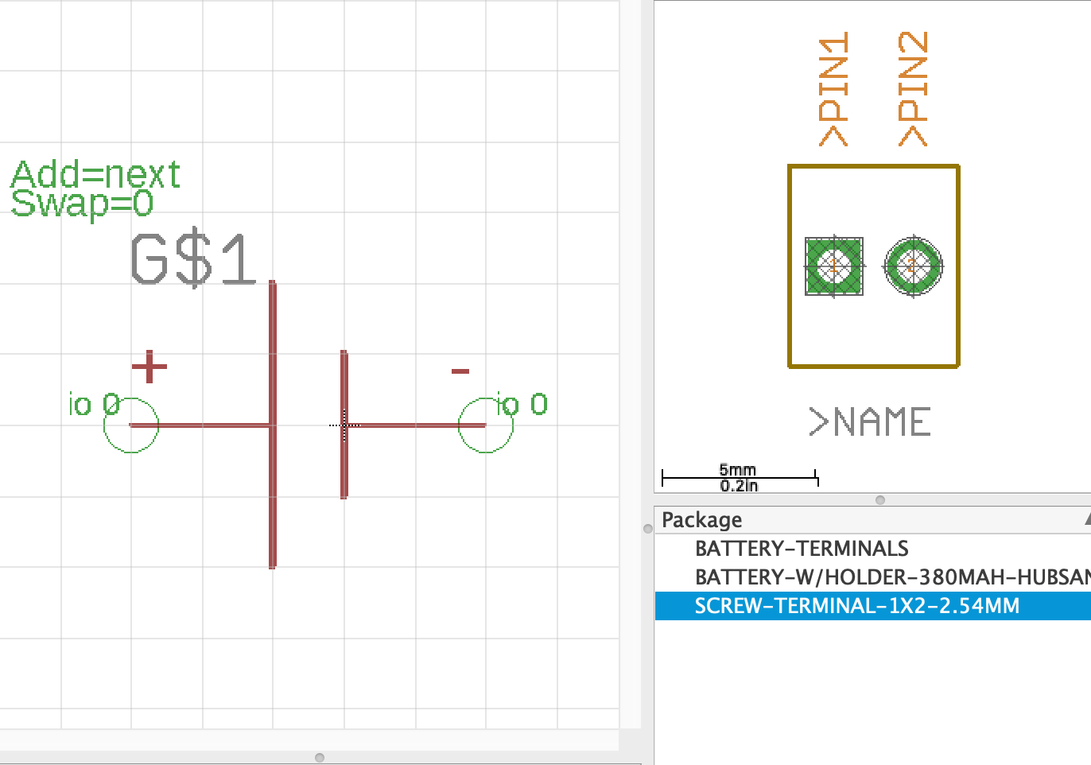
Building Part Libraries in Fusion360
Build some parts in Fusion360
Learn about PCB libraries

Slide 8
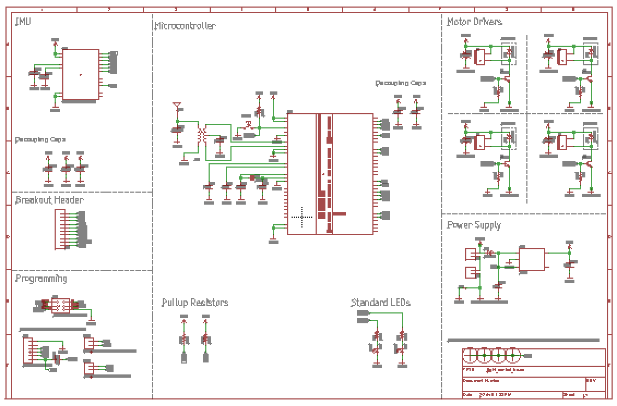
Building The Quadcopter Schematic
Start with a blank sheet.
Build the design by…
Looking at reference designs
Reading datasheets
Interpreting a written spec
Designing from scratch

Slide 9
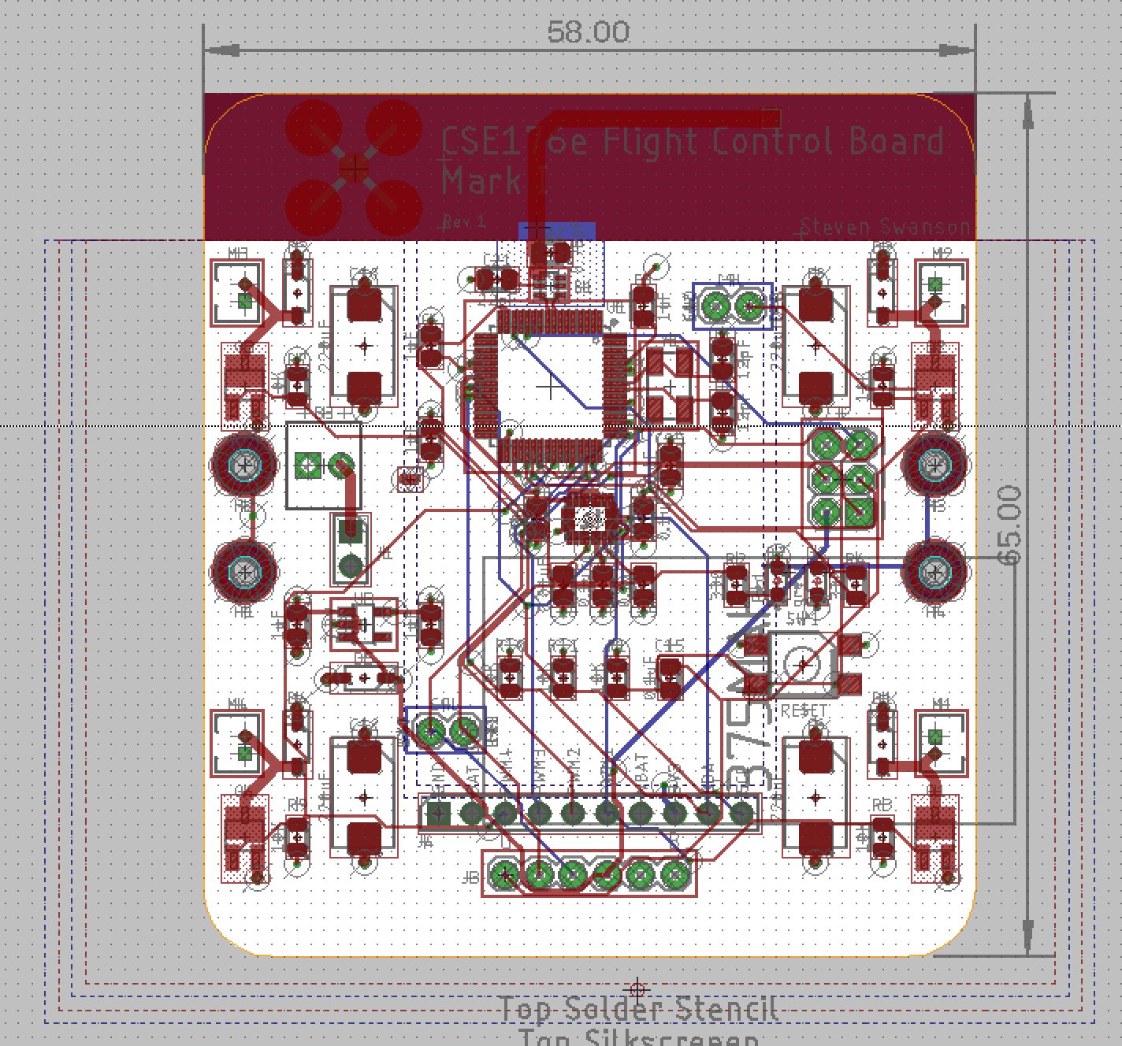
Laying Out The Board
Initial layout
Define the board outline.
Place your parts.
Route the design.

Slide 10
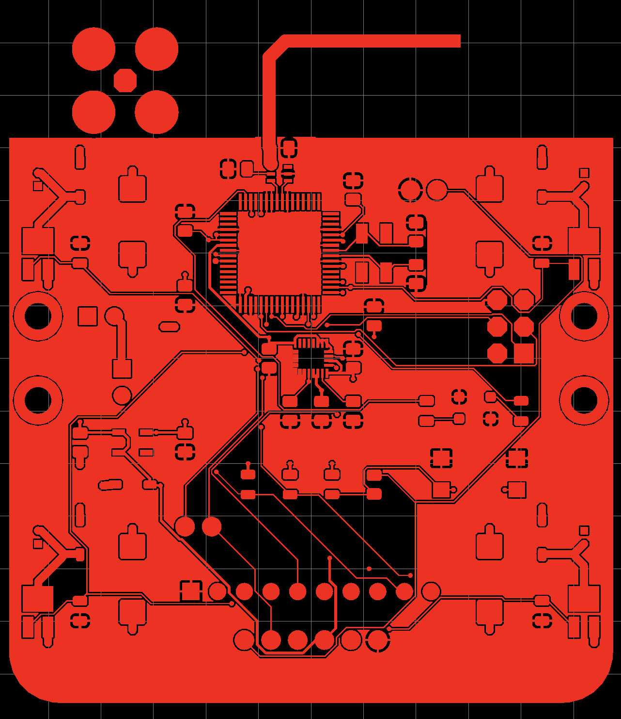
Manufacturing The Board
Your designs must be ready for manufacturing by the beginning of class on November 7.
Early tape out is possible on October 31.
It will take about a week to manufacture them (hopefully)

Slide 11
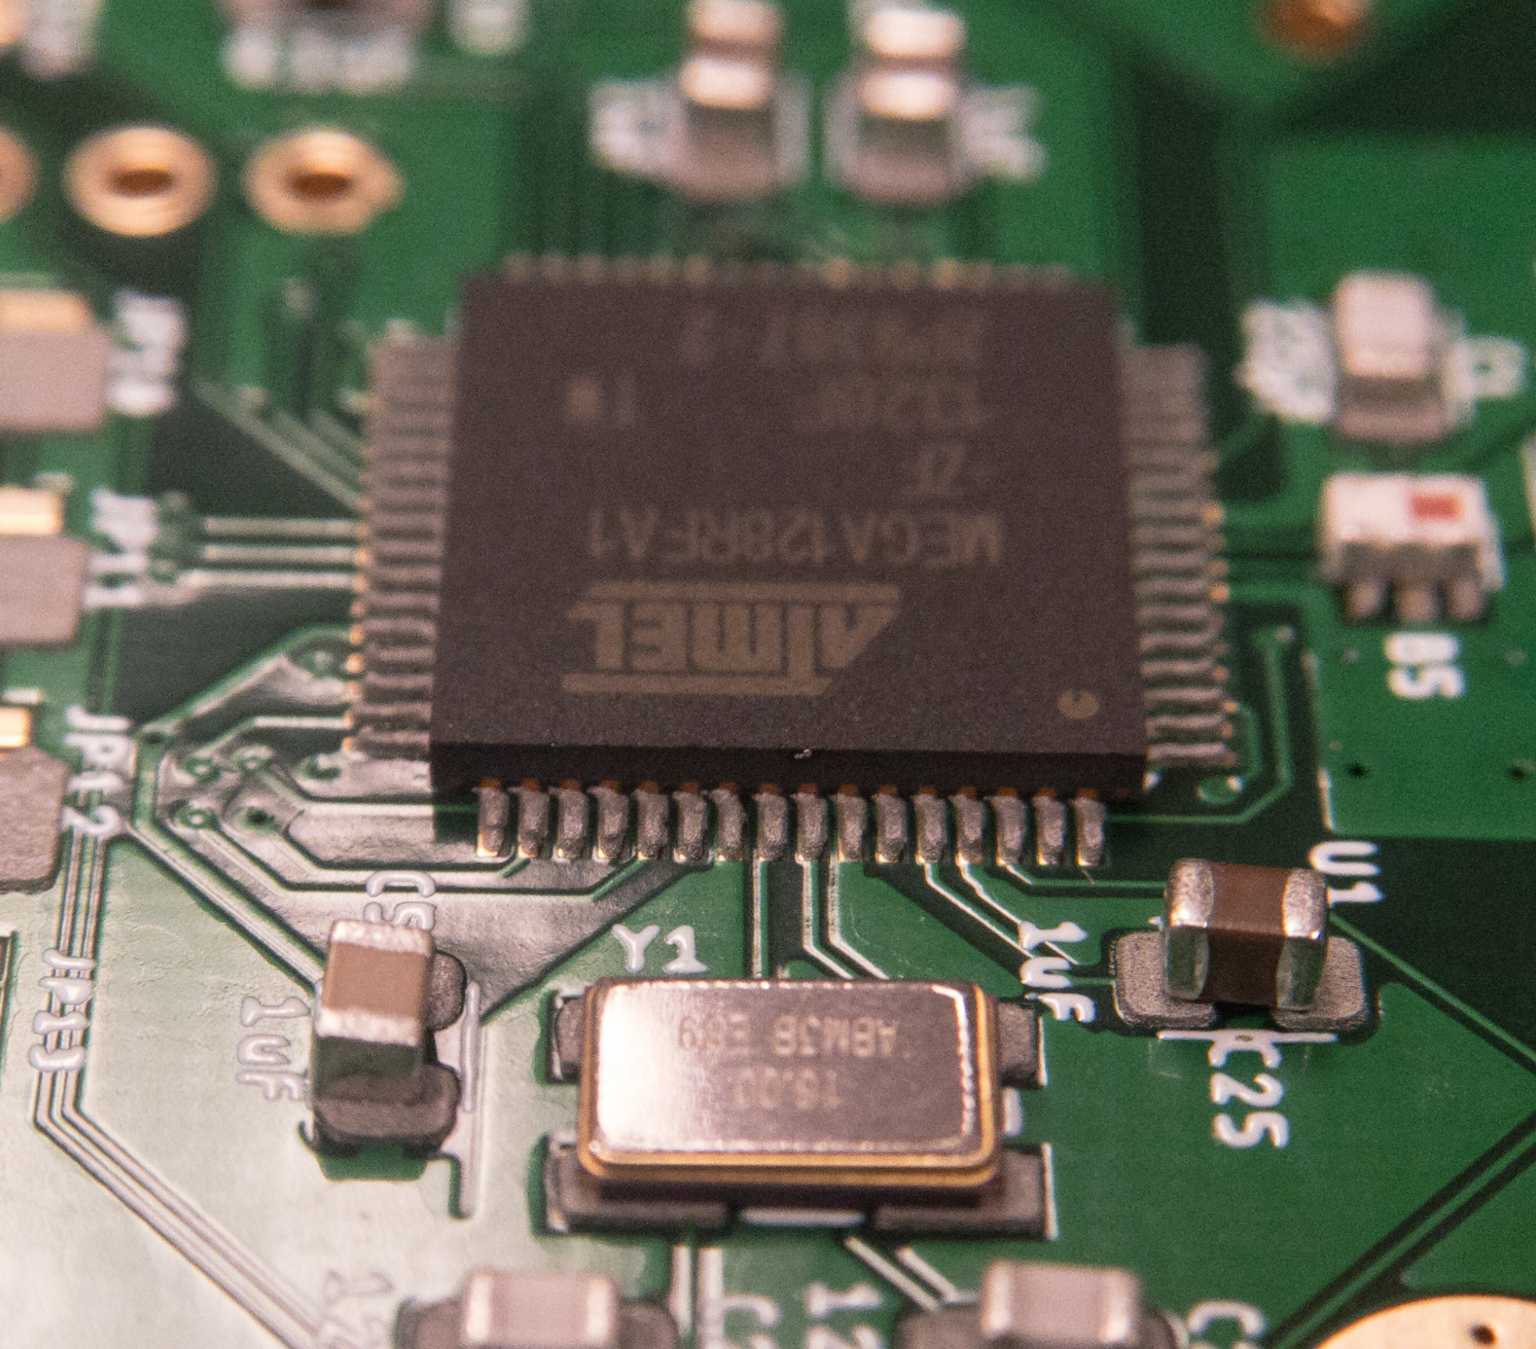
Assembling A PCB
Solder everything to a board
This is hard, so we will do it twice
1st time: Very simple board, very soon
2nd time: Your quadcopter, when it’s ready
Install the bootloader
Test all the board’s parts.

Slide 12
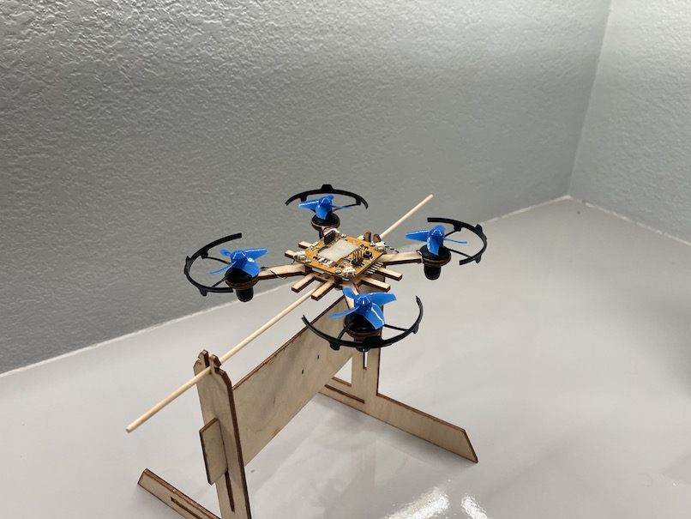
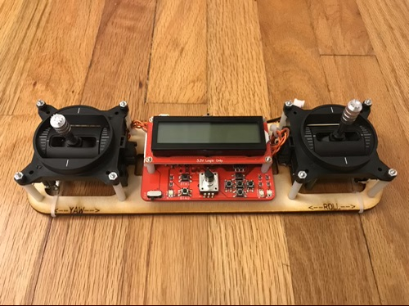
Programming the Hardware
Assemble and use all the test stand and remote
Get all software basics working
Measure gimbals
Measure orientation with the IMU
Communicate wirelessly

Slide 13
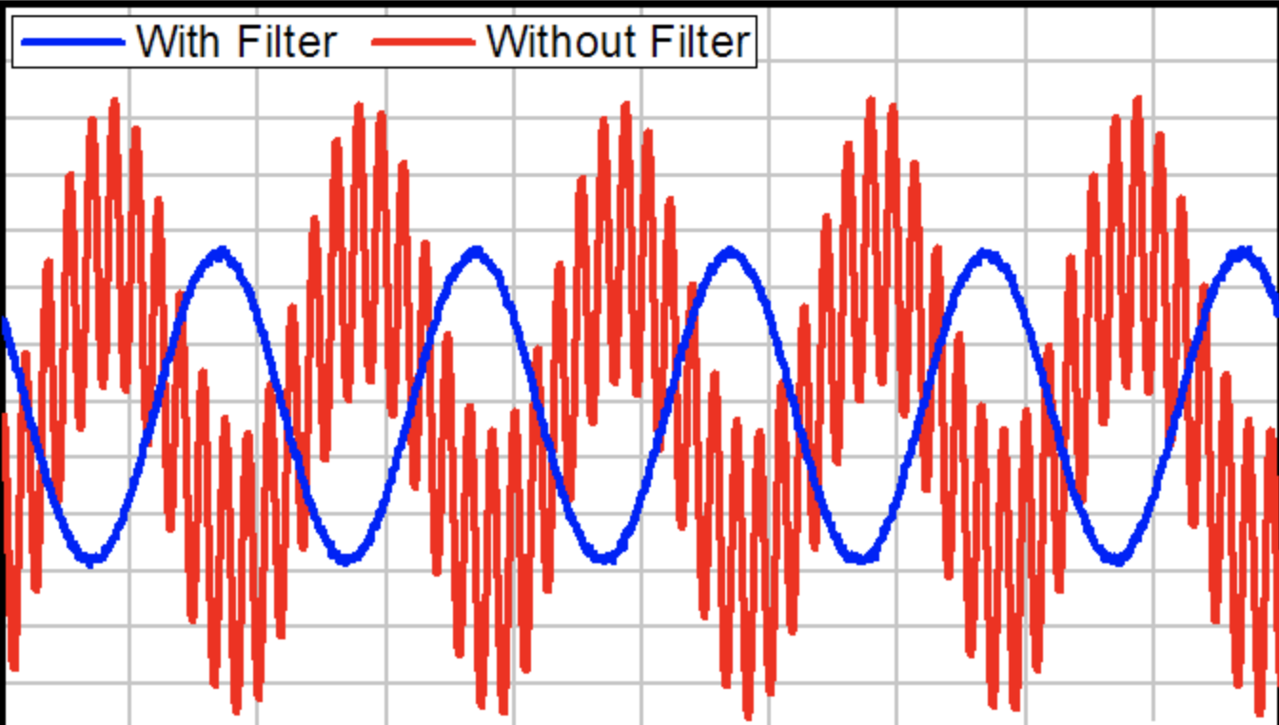
Sensing, Filtering, and PID
Accurately measure orientation on the test stand
Filtering IMU output in hardware and software.
High-pass, low-pass in HW
Complimentary filter in SW
Proportional-Integral-Derivative (PID)
Basic control algorithm
Yaw first
Then Pitch/Roll

Slide 14
Implementing PID
Proportional-Integral-Derivative (PID)
Basic control algorithm
Yaw first
Then Pitch/Roll

Slide 15
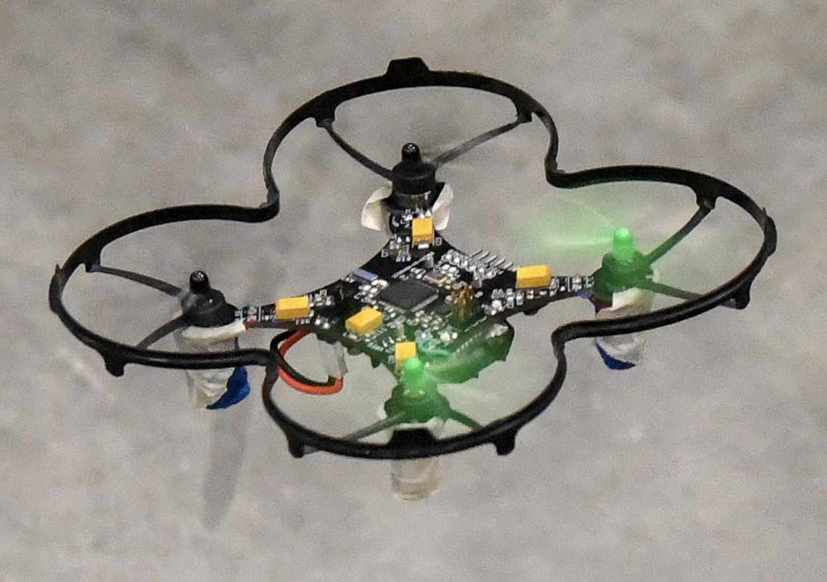
Flight
Extend PID to 3 channels
Implement flight control details
Test, adjust, tweak, debug, etc. until its flight is stable.

Slide 16
Cleanup
Turn in hardware

Slide 17
Lab Logistics

Slide 18
Teams
You will work both in groups and on your own
The first two Fusion360 labs will be on your own.
The rest are completed in pairs of your choosing
In all cases, you can help each other out
No direct copying of source code, designs, etc.
Asking questions, etc. is great.
There is no curve in this class – no need to compete.

Slide 19
The Lab Schedule
The lab schedule is very aggressive
We start a new lab almost every day!
The early weeks there will sometimes be 3 labs going on at once.
Do not fall behind!

Slide 20
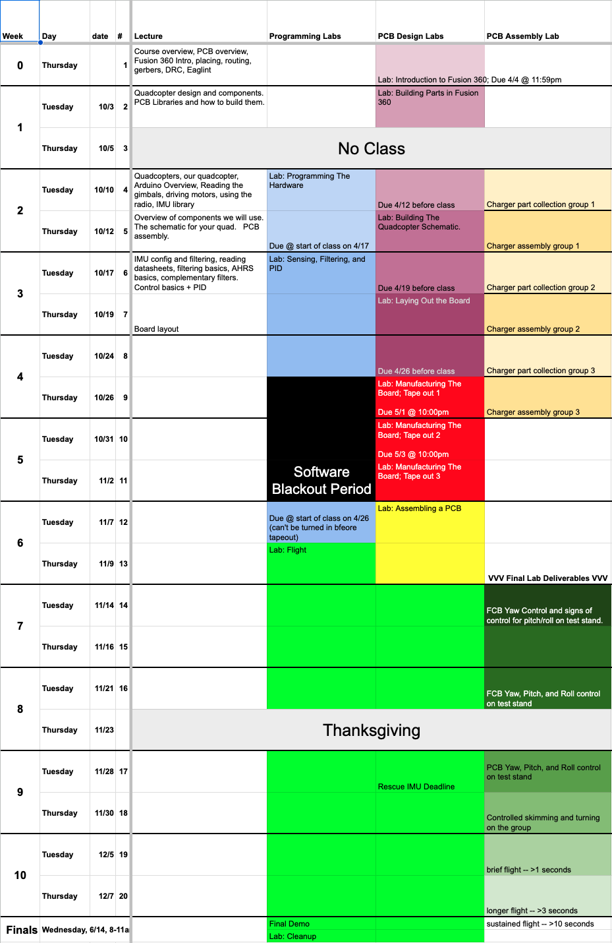
Schedule
The class will move quickly.
You need to meet the check points to succeed.
Do not fall behind!
You need to decide if you are taking the class by the 14th.

Slide 21
Lab Materials
Lab Materials
Distributed via github classroom.
You’ll need a github account.
You’ll need to know how to use git.
To access the lab materials, click on the invitation link included in each lab.
Hardware
We will hand this out in class.
Readings
There’s no textbook, but there are some pre-recorded lectures and demos you’ll need to watch.

Slide 22
Shipping Equipment
We will be shipping you lab equipment at the end of week 2
As part of a lab 1, you’ll fill out a form with your current mailing address (i.e., where we can ship you something)
It will ship when (roughly) you officially register for the class.
You will ship the hardware back to us at the end of the quarter.
We will ship you spare parts as needed.
Do your best to avoid this. We aren’t Amazon, so there will be some lag.

Slide 23
Course Logistics

Slide 24
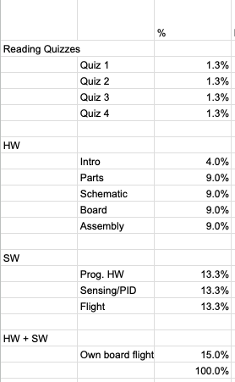
Grading
4 Parts
“Reading” Quizzes
What the videos
5%
HW
Building your board
40%
SW
Implementing flight control
40%
HW + SW
Making your board fly
15%

Slide 25
This is an Intensive, Hands-on Class
Not so much lecturing
Lots of doing.
Your Task
Work Hard
Figure stuff out
Take the initiative
Course Staff Task
Provide high-level guidance
Solve problems
A few lectures
Make sure you have what you need to succeed.

Slide 26
Logistics -- Online
We will meet online (as we are now)
The lectures will either be live or pre-recorded (in which case you should watch beforehand)
You should set aside the class meeting time to work on your project.
Course staff will be readily accessible for questions.
Your group-mate has that time available as well.
Class
11-12:30 Tuesday and Thursday
This includes lecture and lab, but since we are online the line is fuzzy
You must be available for the whole time –
This doesn’t mean you have to be online an ”present” the whole time every day, but you should not book anything else during class.

Slide 27
Logistics
We will meet in person
9:30-12:30 Tuesday + Thursday
There is no podcast (the room is not equipped)
You need to be here, in person for all class meetings.
Sometimes lectures will be short
You should plan to stay anyway to work with your partner
Somedays you will need every minute of 3 hours to complete what’s required (e.g., assembly)
You must complete the Envision Maker Studio responsibility contract: http://makerspace.ucsd.edu/access/responsibility.php

Slide 28
Where to Get Course Materials
Starting points:
Github: https://github.com/NVSL/QuadClass-Resources
Home page: https://sites.google.com/a/eng.ucsd.edu/quadcopterclass/
Course ”readings” and videos:
Lectures
(Pre)recorded and available online (YouTube and/or Canvas) – find them in the course schedule
The slides are in the “Resources” git repo under “Lecture Slides” and in the ‘labs’ directories.
Office hours/lab time consultation
”office hours” will be during class time
Whatever time is left over after lecture and before 2pm

Slide 29
The Waitlist
The course is over-subscribed.
There is a hard limit of 30 people in the class
My goal is to fill those 30 slots.
You need to show up on Tuesday and do Lab 1 on time to keep/have a chance at your spot in the class.
On Tuesday of week 1, enrollment will be decided
If you don’t show up on Tuesday or don’t complete the lab, _and_ you remain enrolled, you will fail the class.

Slide 30
Getting Help
Synchronous help (During class/lab)
Set aside lab/class time to work on your project.
I and the TA will be here to help.
Asynchronous help (other times)
Piazza
Course topics
Fusion360, schematics, board layout – Steve
Flight control software – Steve or Patrick
Equipment problems – Patrick and escalate to Steve as needed
Other topics
Health issues, etc . – email swanson@cs.ucsd.edu (Not piazza)

Slide 31
Logistics -- In Person
We will me in person for specific needs
Distribute equipment
PCB assembly and bring up labs.
We will meet and work in this room (EnVision -- SME)
You must complete the responsibility contract: http://makerspace.ucsd.edu/access/responsibility.php
Obviously, if you are sick, don’t come in.
The assembly labs are easy to delay.
If you have a prolonged illness or need to self-isolate, I will accommodate you.

Slide 32
COVID Caveats
I’m going to try to make this class work
Key assumptions underlying the class
You have access to a computer.
You have access to reference hardware to work on.
You have access to moderately sophisticated soldering equipment.
You have time and space to debug a PCB.
Pessimistic outcome (1)
You are able to design a custom quadcopter.
Realistic outcome (1 + 2)
You are able to design a custom quadcopter and fly a reference design.
Optimistic outcome (1 + 2 + 3 + 4)
You are able to design, build, and fly a custom quadcopter.

Slide 33
Lab Space
We will meet and work in this room (EnVision -- SME)
You must complete the responsibility contract: http://makerspace.ucsd.edu/access/responsibility.php
Class
11-12:30 on Tuesday and Thursday
Lab hours
12:30-2:00 on Tuesday; 12:30-2 and Thursday
The line between class and lab hours is blurry.

Slide 34
Readings And Quizzes
The course schedule has “readings” (mostly videos) you need to watch before class.
There’s a quiz to make sure you actually watch them.
It is really important that you watch these videos and come prepared with questions.
If I feel like people aren’t, I’ll make the quizzes harder.
It gives us more time in class for
One-on-one help
Questions
Test flights
Assembly
Less lecturing
There’s one on the schedule for today, but I forgot to announce/assign it early enough. So it’s due tonight at midnight.

Slide 35
Research Opt-Out
I sometimes write papers about this class
I collect data from students to measure its success, etc.
You can opt out of having your data used for this purpose.

Slide 36
Self-evaluation Survey
As part of the first lab, you’ll fill out a self-evaluation survey.
Submit the confirmation with your first lab.

Slide 37
Questions?

Slide 38
Questions For You…
What’s the most effective way to collect/answer questions about the pre-recorded lectures?
What’s the most effective way to manage virtual office hours?
What’s the best idea you’ve seen in teaching an online course?

